Slide 1
SFC MUARIK
Roadmap

Slide 2
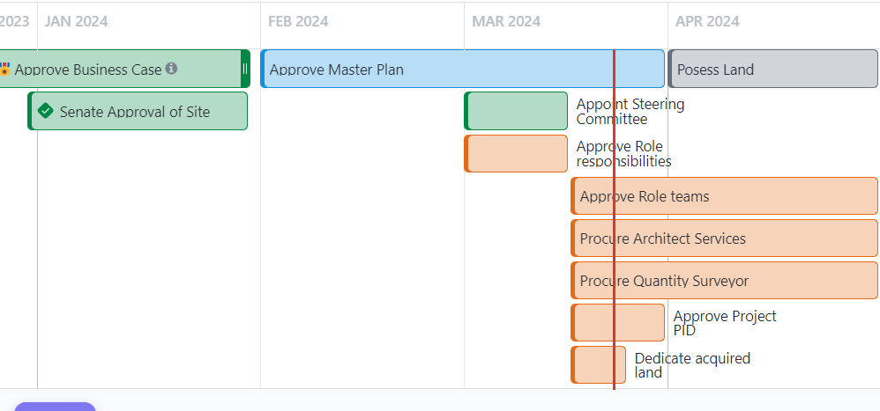
JAN-APR’ 2024

Slide 3
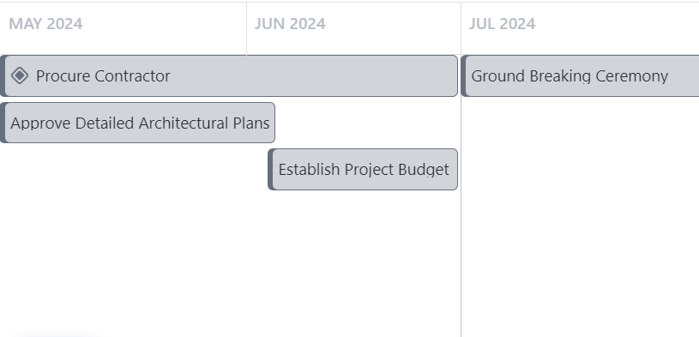
MAY-JULY’ 2024

